Slide 1


Language Learning Application
Hi!
Aluu!
Salut!
Jambo!
Oi!
Supervisor: Mr. Alex Keselman Students: Oneill Panker & Roman Gury

Slide 2
Agenda
01
02
03
04
Introduction
Solution
Model Architecture
Challenges

Slide 3
Introduction

Slide 4
Introduction
An estimated half of the world’s population is bilingual
Learning new languages is standard in primary and secondary education across the globe
Online learning courses typically suffer from low retention rates
Courses often lack clear instructions, examples and support for the students

Slide 5



Existing Solutions
Amount of content varies from one language to another
Reliance on repetition
Limited vocabulary diversity
Limited Interactive dialogue support
Limited amount of exercises
No dialogue practice

Slide 6
What is Gamification?
Engagement
Motivation
Learning
Incorporates elements such as points levels and achievements to make tasks more compelling
Challenges, rewards, and personalization encourage the user to keep interacting with the app
The features of gamification provide the user with the desire to learn and make the educational experience more enjoyable
Notes:
Engagement: Gamification harnesses the motivational aspects of games, such as competition, rewards, and progression, to increase engagement and participation in activities. By incorporating elements like points, levels, badges, and leaderboards, gamification makes tasks more enjoyable and compelling, encouraging users to interact with them more frequently and for longer durations.
Motivation: Gamification taps into intrinsic and extrinsic motivations to encourage desired behaviors and achieve specific goals. Intrinsic motivations, such as autonomy, mastery, and purpose, are fostered through features like meaningful challenges, skill development, and personalization. Extrinsic motivations, such as rewards, recognition, and social influence, are encouraged through features like virtual rewards, status symbols, and social interactions.
Learning and behavior change: Gamification can be a powerful tool for promoting learning and behavior change by making educational or developmental activities more engaging and motivating. By providing immediate feedback, clear goals, and a sense of progress, gamified experiences enhance motivation and retention, facilitating skill acquisition, knowledge transfer, and positive behavior modification.

Slide 7
Solution

Slide 8

AI Driven Application
Hi!

Slide 9
Solution
Personalized Language paths using AI to adapt to user levels and preferences
Interactive dialogues with ChatGPT to simulate real conversations
Daily challenges and quizzes to engage and test users
Gamification elements like points, badges, and levels to motivate learners

Slide 10
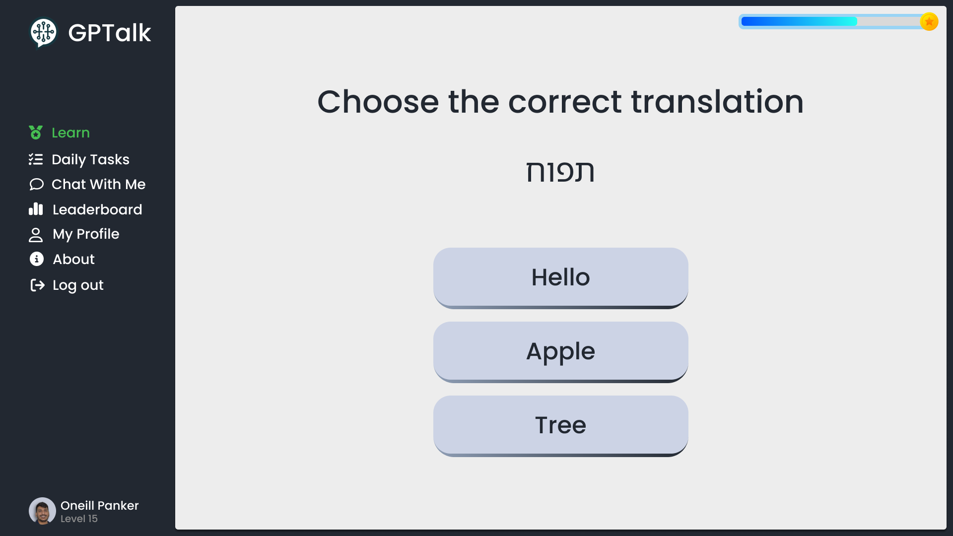
Quiz

Slide 11
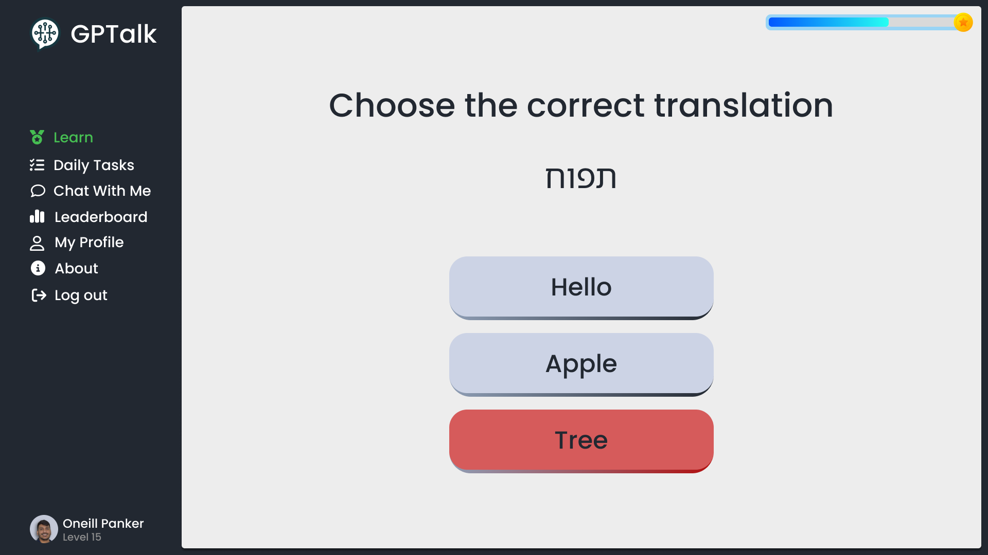
Quiz

Slide 12
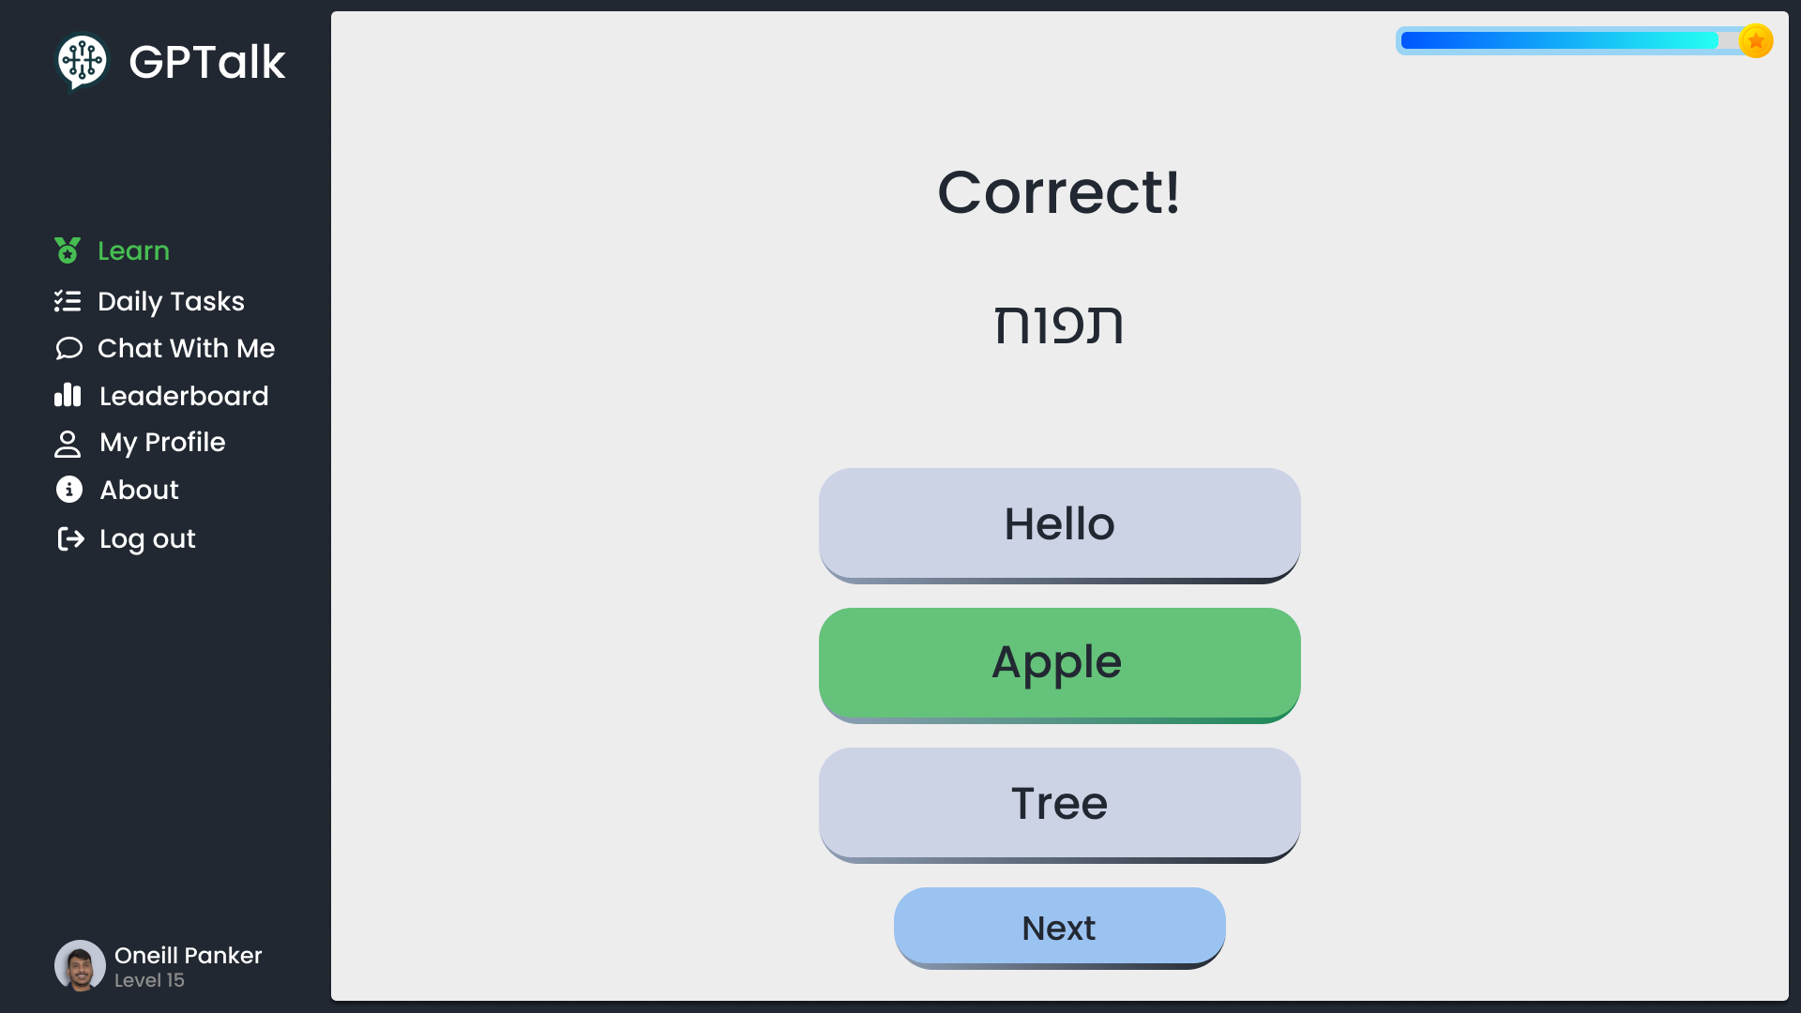
Quiz

Slide 13
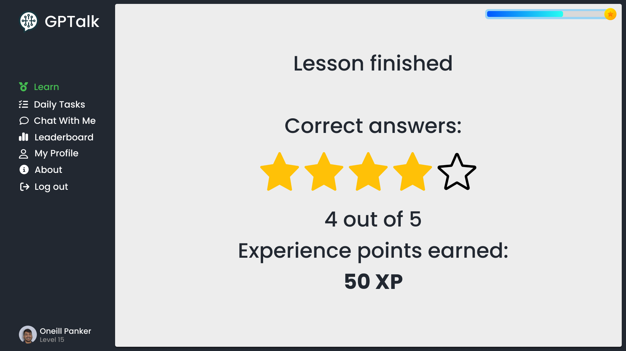
Gamified Quizzes

Slide 14
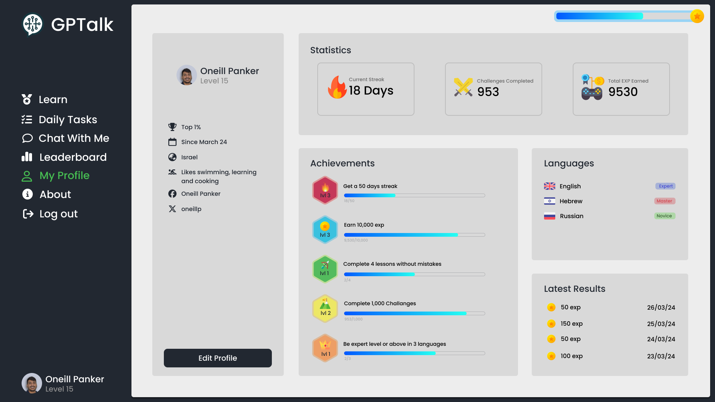
Gamification Dashboard

Slide 15
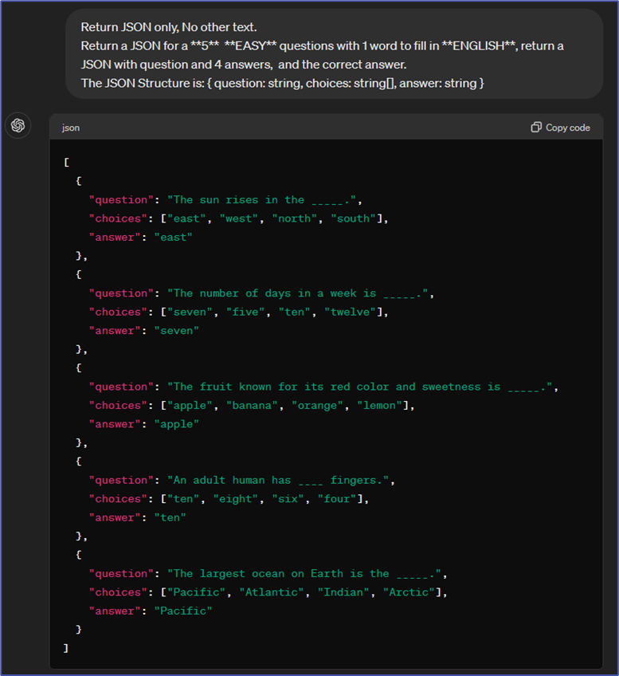
ChatGPT Prompts
Notes:
Specifying the output format (JSON), without additional text in the response.
Using a prompt template to allow the use of dynamic parameters in the prompts.
Limiting the number of questions in the response.
Specifying language of the exercise we are generating.
Specifying the difficulty of the generated exercise.
Specifying the type of the generated exercise.
Requesting the generated response to be printed in a specific structure.
Usage of various keywords to get a more accurate result.

Slide 16




Technology Stack
Angular
Express.js
MongoDB
ChatGPT
For responsive and dynamic UI
Efficient server-side logic
Flexible data storage
Interactive content generation

Slide 17
Model Architecture

Slide 18

Application Architecture
ChatGPT
Send prompts /
Receive responses
Use the
website
Send / Receive
requests
Client
Server
User
Save / Retrieve
data
Database

Slide 19
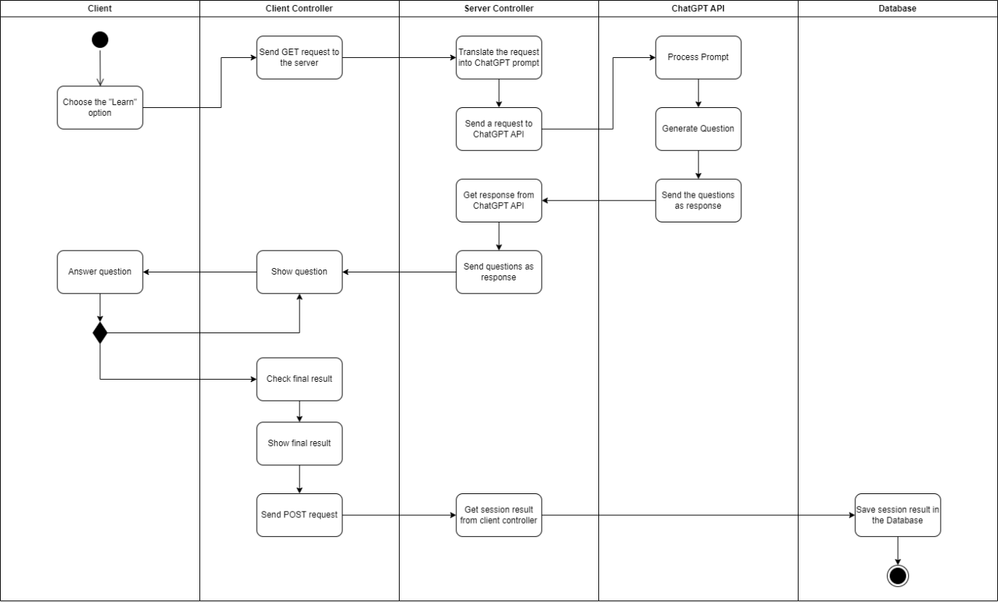
Activity Diagram – Learning Session

Slide 20
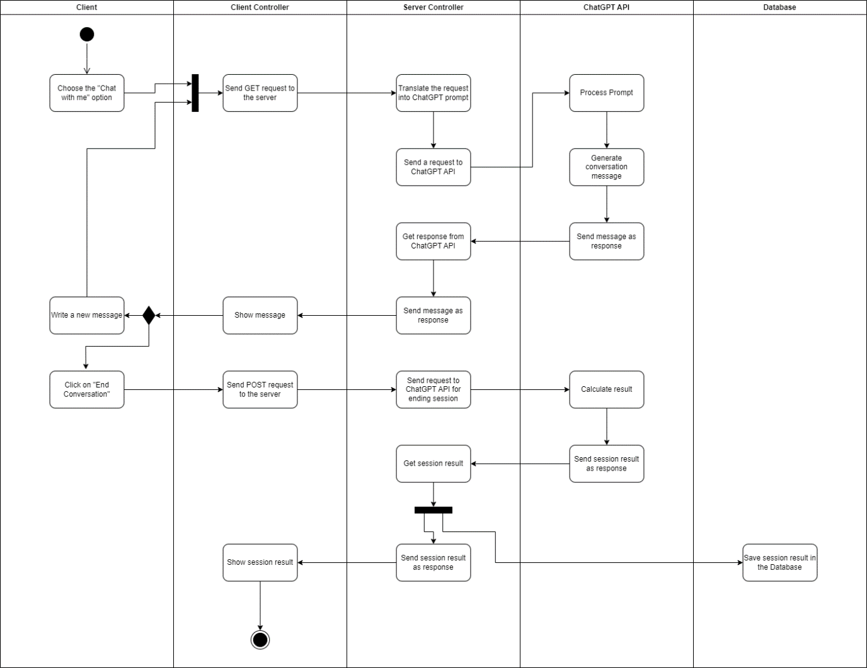
Activity Diagram – Chat Session

Slide 21
Verification
Test Name | Description | Expected Result
Logout functionality | The user clicks the logout button | The system successfully logs the user out
Sidebar navigation | The user clicks a nav item on the sidebar | The user is redirected to the relevant page
Chat mode functionality | The user enters the “chat with me” page and starts a conversation | The user successfully completes a conversation with the ChatGPT chatbot
Learn mode functionality | The users enters the “learn” page and starts a lesson | The user completes a full lesson
Leaderboard functionality | The user enters the “leaderboard” page | A list of high scores by fellow users is displayed on the page
My Profile functionality | The user enters the "My Profile" page | Displays the details of the user currently logged in
About page functionality | The user enters the “About” page | Displays technical information about the application

Slide 22
Challenges
Integration Complexity
Accuracy and Reliability
Scalability
User Experience
Notes:
Integration Complexity
Combining ChatGPT with out custom systems.
Ensuring seamless data flow between frontend, backend, and database.
Accuracy and Reliability
Maintaining high accuracy in language tasks generated by ChatGPT.
Handling varied user inputs and providing relevant feedback.
Scalability
Designing the backend to handle many concurrent users.
Scaling the system as user base and data volume grow.
User Experience
Creating an intuitive interface that accommodates diverse user groups.
Ensuring quick response times and minimal downtimes.

Slide 23
THANK YOU FOR LISTENING
Goodbye!

